Slide 1


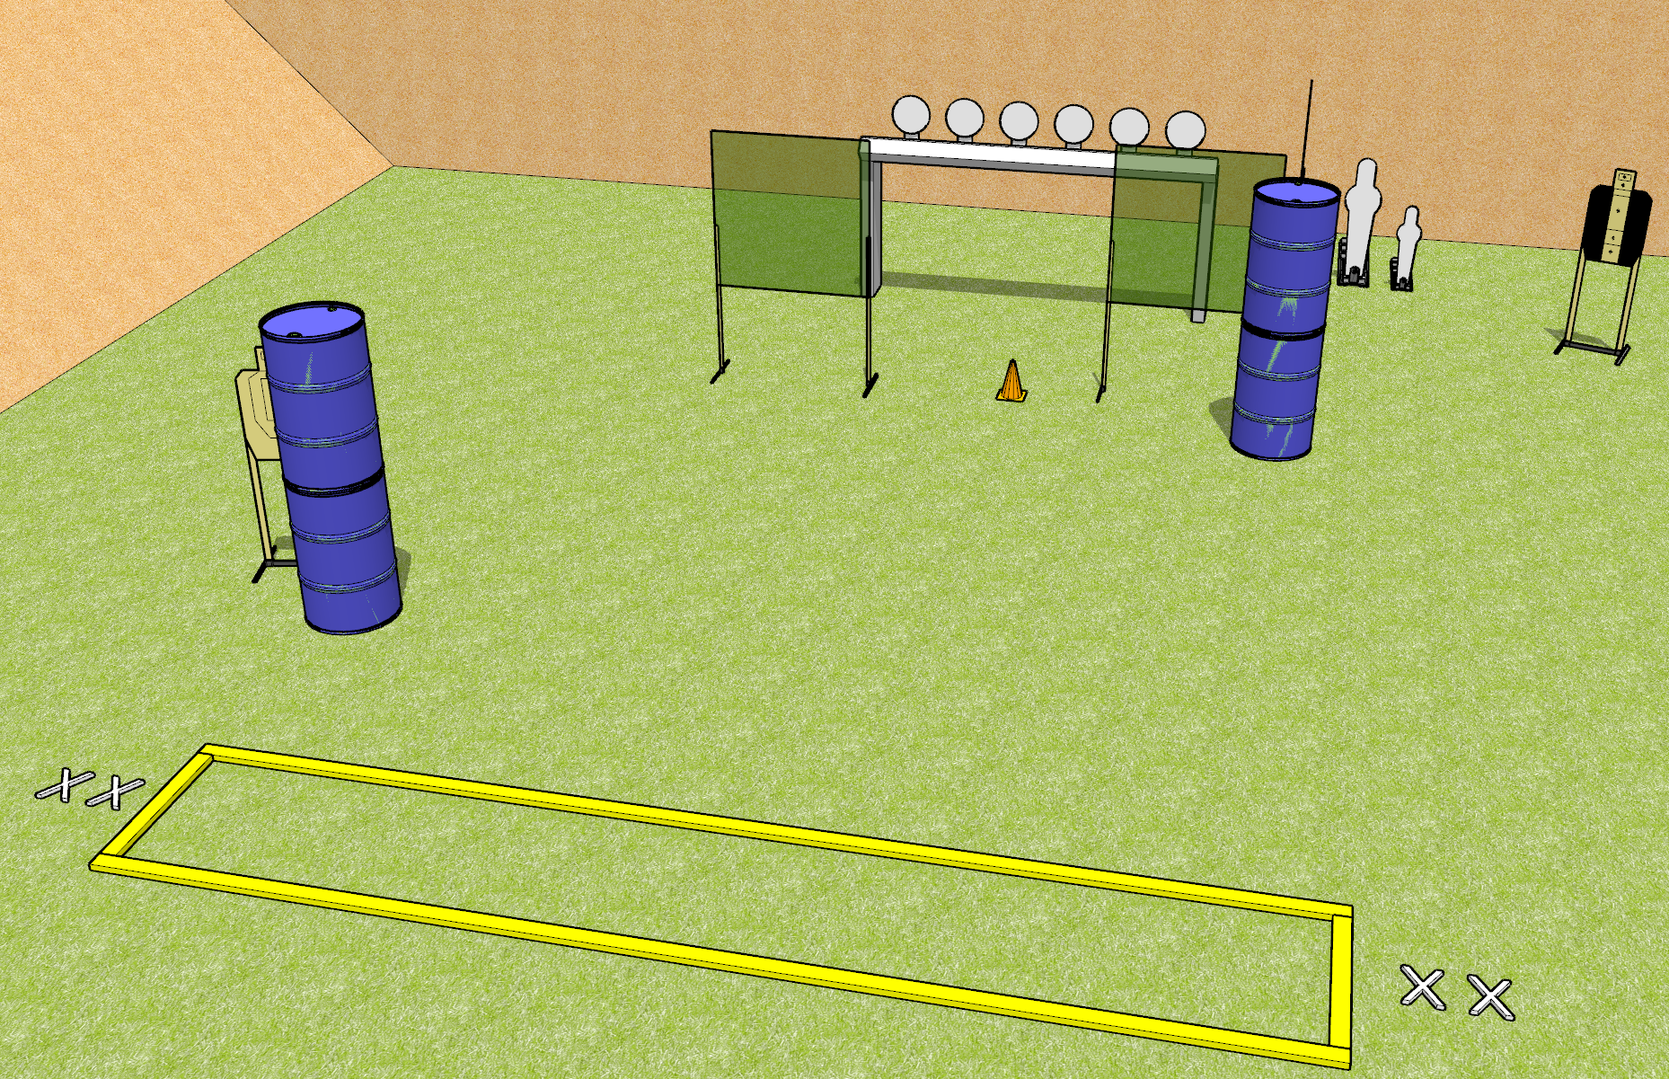
 | Dothan Gun Club – USPSA Match Left or Right Course Designer : Drew Coleman
START POSITION : Standing with both feet on either set of X's, outside the shooting area
GUN READY CONDITION : Pistol loaded and holstered. PCC shouldered, safety on, pointed at orange cone. |  | SCORING: Comstock, 12 rounds TARGETS: 4 paper, 8 Steel SCORED HITS: Best 2 on paper, steel until down START-STOP: Audible, last shot RULES:
STAGE PROCEDURE: Engage targets as they become available from within the fault lines.

Slide 2
Notes
Left or Right
Leftmost two plates should not be visible with the leftmost paper
Rightmost two plates should not be visible with the pepper popper

